Slide 1


License Plate Recognition
Mihályi Géza. IL1VCP

Slide 2
Problem
License Plate Detection from an Image
An image containing a car was provided, and an algorithm needs to be designed to extract the license plate number from the image.

Slide 3
Solution
Object Detection
First part was to detect the license plate on the picture. I trained a YOLOv8 model for this task.
License Plate recognition
For this part, MATLAB functions were implemented. Put the picture to grayscale. Then created a binary image from this grayscale.
Aftetr that with dilation and erosion noises were cleaned up.
In the last step the MATLAB built-in ocr recognition function were used, to detect the numbers and letters in the picture

Slide 4
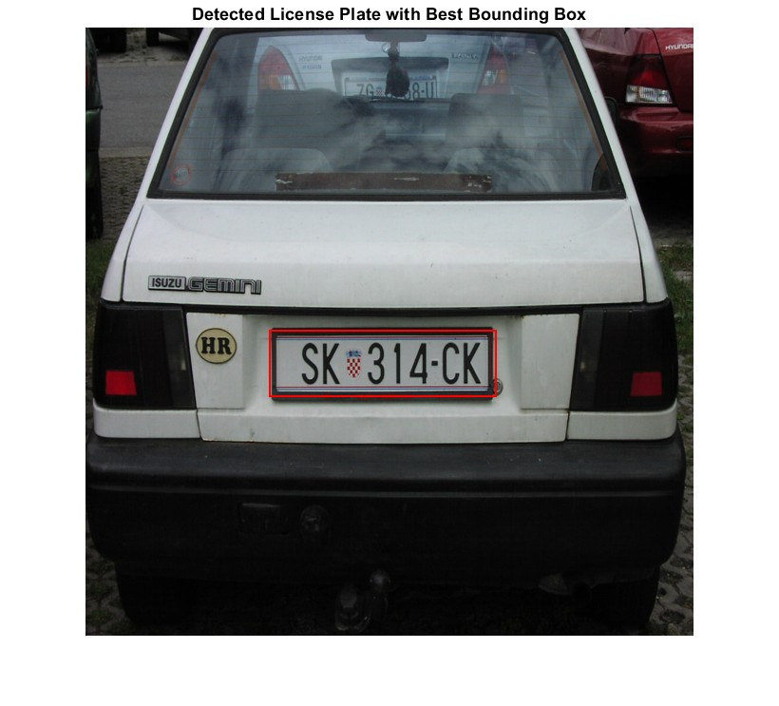

Some Solution I.

Slide 5
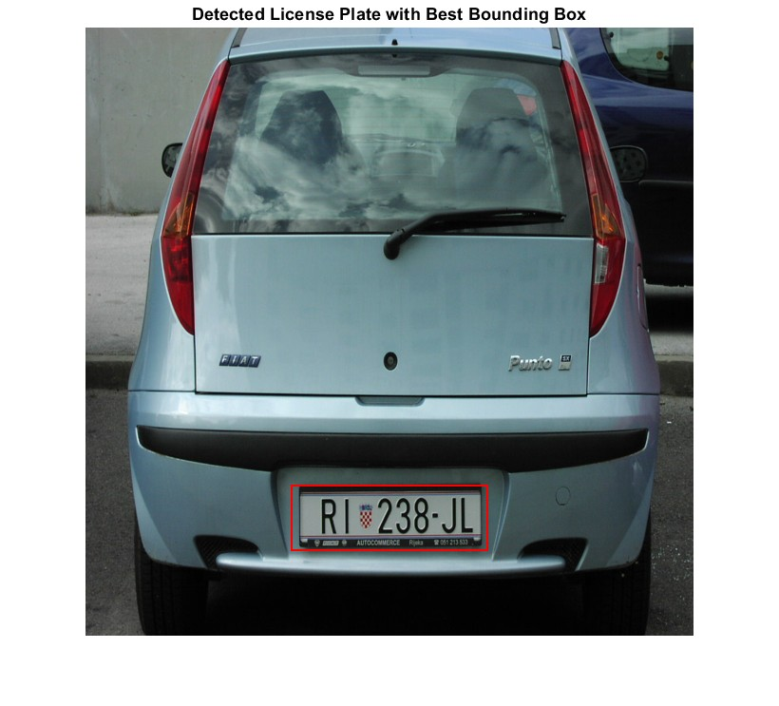
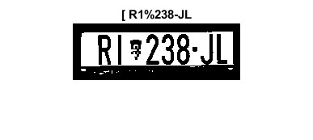
Some Solution II.

Slide 6
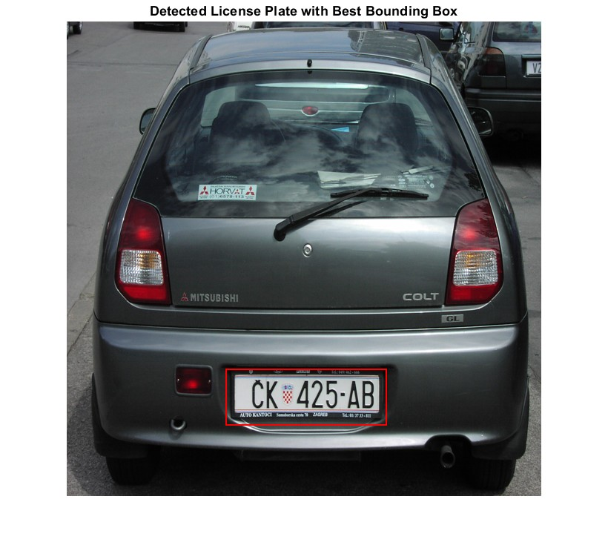
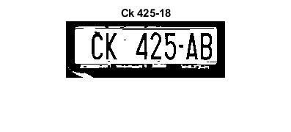
Some Solution III.

